Slide 1
RBFs, competitive learning and SOMs
Artificial Neural Networks and Deep Architectures – Lab 2
Kevin Dalla Torre, Franco RUGGERI, Fredrik Danielsson

Slide 2
Regression with RBF NN Generalization and # RBF units, no noise
Threshold | Sin(2x) | Square(2x) | Square(2x) (output transformed)
0.1 | 6 | - | 6
0.01 | 6 | - | 9
0.001 | 10 | - | 9
0 | - | - | 9
Conclusions:
Increasing # RBFs → better fit
Performance evaluated on test set
Threshold at the output → fit perfectly square function (useful in classification problems)

Slide 3
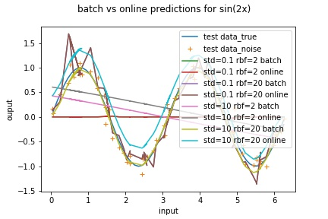
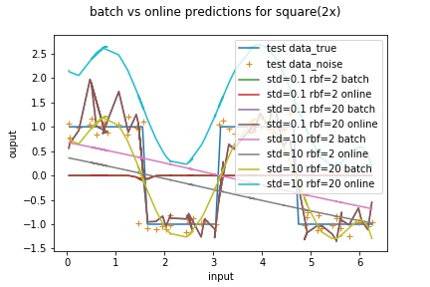
Regression with RBF NN Batch and online learning vs # RBF units and width, with noise
…
Conclusions:
Large # RBFs and small (but not too much) width → good
Large # RBFs and too small width → peaks
Small # RBFs and high width → tends to be steady (extreme case: straight line).
Small # RBFs and small width → isolated peaks (portions of input space not covered)

Slide 4
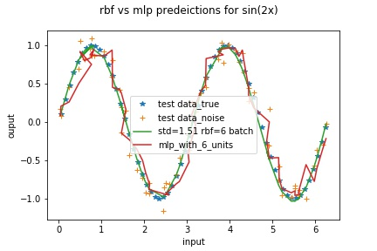
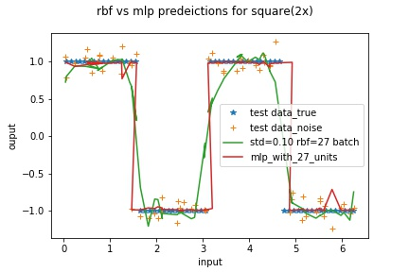
Regression with RBF NN Batch RBF vs MLP
…
Conclusions:
RBF NNs perform better for the sinusoid, not for the square function (linear combination of RBFs can’t get the straight lines)
RBF NNs with batch mode are faster, closed-form solution (vs BackProp that is iterative)

Slide 5
Regression with RBF NN Initialization of RBFs
# RBF | Random | Uniform
6 | 0.50 | 0.48
20 | 0.32 | 0.14
43 | 0.17 | 0.09
Conclusions:
Uniform initialization gets on average better results

Slide 6
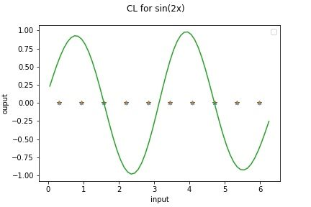
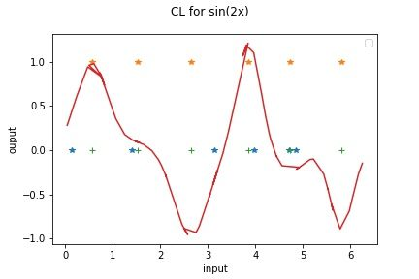
Competitive learning Uniform initialization vs CL
Uniform on the left.
CL on the right.
…
Conclusions:
Uniform initialization: error 0.216
CL initialization with 2 winners: error 0.351

Slide 7
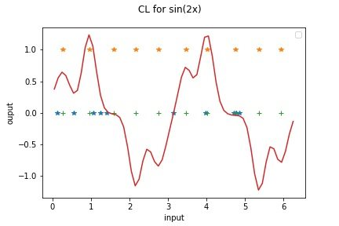
Competitive learning 2 winners vs 3 winners
2 winners on the left.
3 winners on the right.
…
Conclusions:
2 winners: error 0.351
3 winners: error 0.209

Slide 8
Dimensionality reduction with SOM 1D output space and natural ordering
dragonfly | grasshopper | beetle | butterfly | mosquito | housefly | spider | frog | sea turtle | crocodile
ostrich | penguin | duck | pelican | walrus | ape | bear | hyena | dog | cat | lion
…
Conclusions:
The SOM algorithm finds a mapping 84D → 1D that preserves the topology
The output dimension defines a natural ordering for the animals

Slide 9
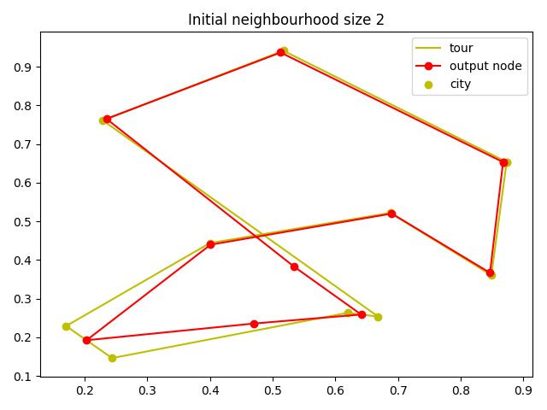
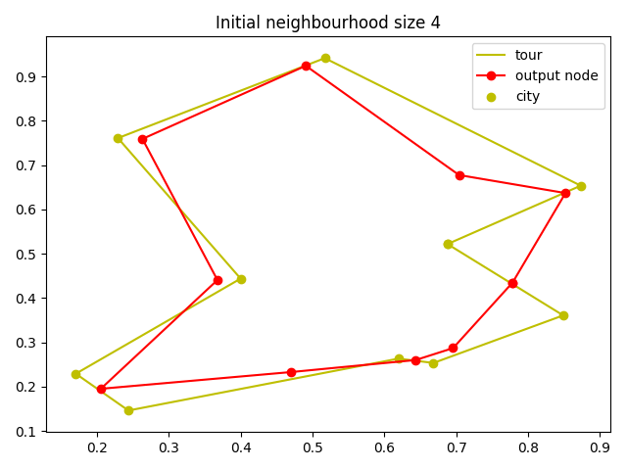
Dimensionality reduction with SOM Circular 1D output space
…
Conclusions:
The starting neighborhood size must be large to get the global topology
The output nodes are positioned in the input space close to the patterns, some nodes in the middle
The cities sorted by winner define a short tour

Slide 10
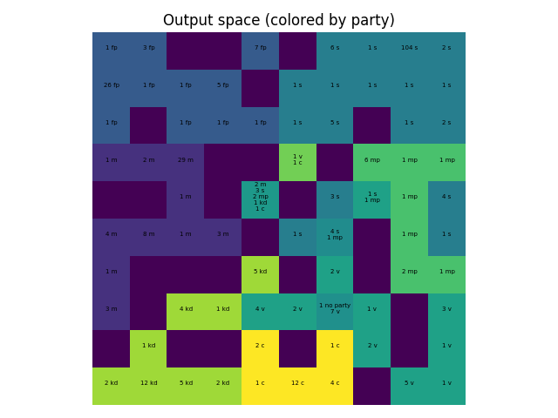
Clustering with SOM 2D output space
Conclusions:
Similar MPs (i.e. similar votes) are clustered together
X-axis: parties are organized according to the left-right scale (inverted)
Y-axis: curiously another dimension is relevant
…

Slide 11
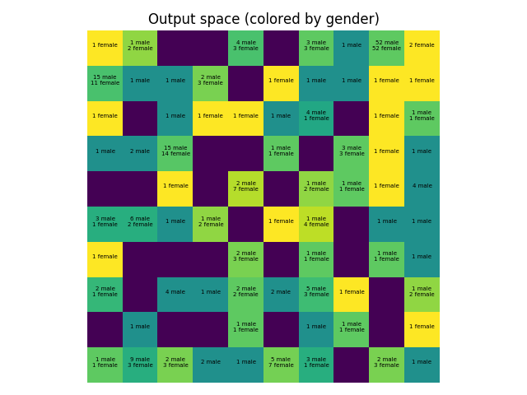
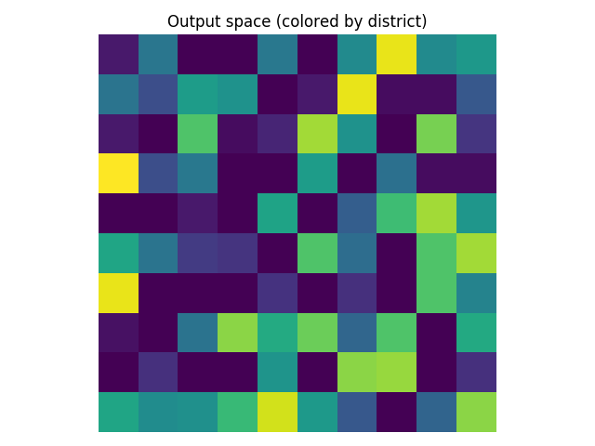
Clustering with SOM 2D output space
…
Conclusions:
Similar MPs (i.e. similar votes) are clustered together
Small clusters also relative to gender and district

Slide 12
THANK YOU!

